Slide 1
Google Self-Driving Car
Tyler Houseweart

Slide 2
Why do we need self-driving cars?
Cost
Notes:
Self-driving cars are predicted to save consumers a lot of money
-Rides should end up being cheaper than taxis
-With efficient ride sharing, car ownership would decrease (less emissions too!)

Slide 3
Why do we need self-driving cars?
Cost
Productivity
Notes:
-Average commuter spends 24 to 28 minutes each way sitting in traffic
-Americans spend over 30 billion hours per year sitting in their cars
-Can spend commuting time doing other things
-With widespread adoption, traffic congestion can be eased – cars pick optimal routes and speeds to ease gridlock
-No need to search for your car or parking – it will drop you off, park itself, and pick you up again later

Slide 4
Why do we need self-driving cars?
Cost
Productivity
Safety
Notes:
Death stats: 33,000 people killed each year in car accidents in U.S. (leading cause of death for those between 4 and 34)
Worldwide: 1.2 million killed each year.
93% of these deaths are caused by human error
Allows passengers to get around safely who wouldn’t be able to otherwise
-Children
-The elderly
-Inebriated
-The visually-impaired

Slide 5
Other Self-Driving Cars
Continental
Nissan
Audi
Tesla
Mercedes
and more…
Notes:
Many companies working on self-driving prototypes.
They mainly differ in their levels of autonomy

Slide 6
National Highway Traffic Safety Administration (NHTSA) Classification System
No Automation (Level 0)
Function-Specific Automation (Level 1)
Combined Function Automation (Level 2)
Limited Self-Driving Automation (Level 3)
Full Self-Driving Automation (Level 4)
Notes:
O: Driver in complete and sole control of the primary vehicle controls – brake, steering, throttle – at all times.
1: One or more Automated control functions. Examples: electronic stability control or automatic braking systems
2: At least two Automated primary control functions designed to work in unison. Example: Adaptive cruise control in combination with lane centering.
3: Driver can cede full control of all safety-critical functions under certain traffic or environmental conditions and in those conditions to rely heavily on the vehicle to monitor for changes in those conditions requiring transition back to driver control. The driver is expected to be available for occasional control, but with sufficiently comfortable transition time.
4: The vehicle is designed to perform all safety-critical driving functions and monitor roadway conditions for an entire trip. Such a design anticipates that the driver will provide destination or navigation input, but is not expected to be available for control at any time during the trip. This includes both occupied and unoccupied vehicles.

Slide 7
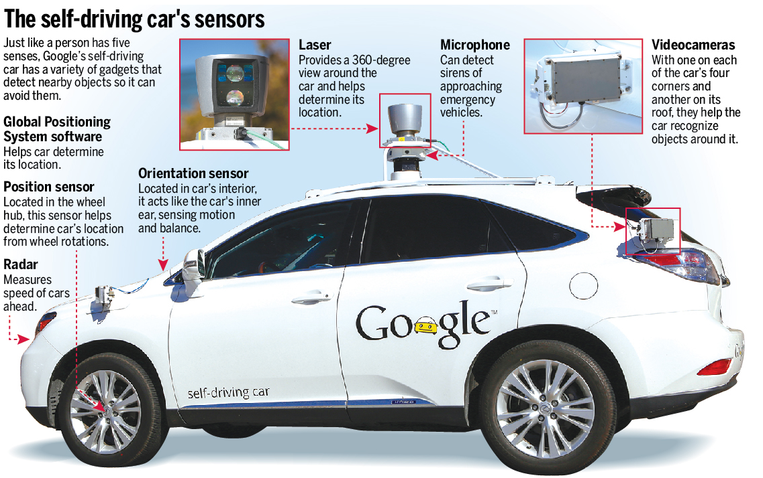
Notes:
GPS – provides macro-level location data with accuracy of 1.9 meters
Position Sensor – measures wheel rotations, integrates with GPS to find the finer-level location
Orientation sensor – uses accelerometer and gyroscope to sense the car’s motion and balance
RADAR – used to measure the speed of cars and pedestrians ahead to predict their motion -- very versatile: can see through trees and underneath cars
Max FOV: 60 deg. Max Dist.: 200 meters
SONAR – used in conjunction with the RADAR to detect very close objects
Max FOV: 60 deg. Max Dist.: 6 meters
Stereoscopic Cameras – Used to determine fine position of car and other objects, and image recognition (stop signs, stop lights, etc)
Horizontal FOV: 50 deg. Vertical FOV: 10 deg Max distance: 30 meters
LiDAR – heart of the system. Velodyne 64-beam Laser. Horizontal FOV: 360 deg. Vertical FOV: 30 deg. Max. Dist: 100 meters
-Provides 3D map of environment with cm-level accuracy

Slide 8
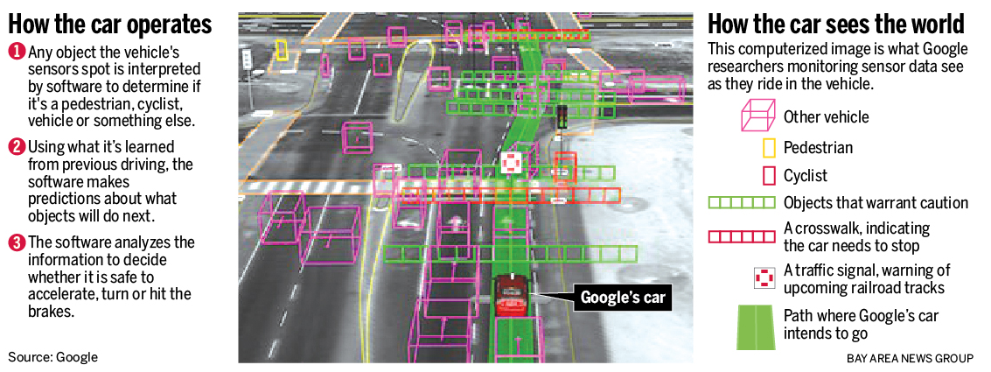
Software
Notes:
Software is constantly updating predictions, and adjusting the car’s planned path accordingly --- 200 times per second

Slide 9
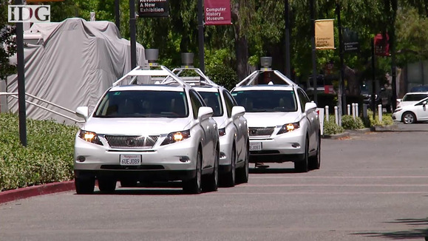
Retrofitted Hybrid
Notes:
-Currently testing on roads with at least 10 retrofitted hybrid cars
- 6 Toyota Prius
- 1 Audi TT
- 3 Lexus RX450h
-This fleet has driven over 700,000 combined miles so far
LEVEL 3 AUTONOMOUS VEHICLES:
-Each one has a passenger to monitor data and computer readings and provide feedback, and a driver to take over control of the car if necessary

Slide 10
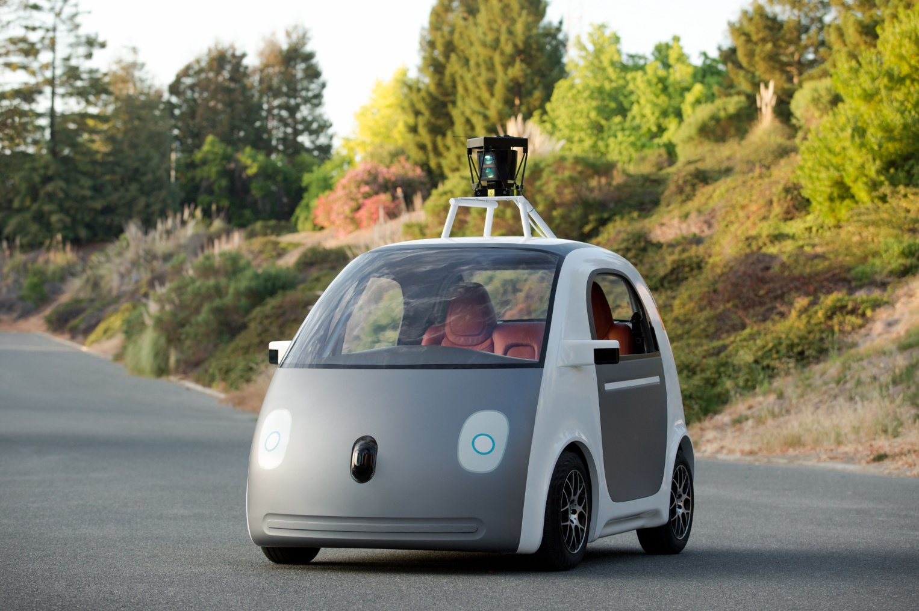
Fully Autonomous Prototype
Notes:
- LEVEL 4 Autonomous: No steering wheel, brake pedal, or gas pedal --- Just a button to start and stop
Fully electric
25 miles per hour max
Redundant braking and redundant steering systems – According to Google, the first ever in a car
Computer in back of car, gets very hot, ruggedized computer for this environment
Soft round edges curve away from the sensors to enhance FOV
Will be tested on roads at NASA’s Ames Research Center in Moffett Field, CA. Gets around state legislation because the grounds are federal property.
Car has friendly appearance (face) to help with public perception

Slide 11
Challenges – Extreme Conditions
Rain and snow
Potholes
Parking lots, parking garages
Cop vs. pedestrian
Paper vs. rock
Unmapped areas
Unexpected situations
Notes:
-Can’t yet handle heavy rain and snow, mostly been tested in sunny Mountain View California
-Potholes
-Parking lots, parking garages
-Can’t yet distinguish between traffic cops and normal pedestrians
-Can’t distinguish between harmless objects (crumpled paper) and harmful objects (rocks), currently avoids both
-Currently, route must be pre-mapped in high detail
-Can handle unmapped stop signs and construction signs
-Can’t handle unmapped street lights (but will stop for traffic!)
-During testing, car came on an old woman in a motorized wheelchair chasing a duck with a broom. The car was confused so it stopped and wouldn’t go on

Slide 12
Challenges – Ethics
Whose lives should be prioritized?
Who should choose “ethics setting”
Who is liable for a crash?
Notes:
In an unavoidable crash, whose lives should be prioritized?
-Minimize damage to car passengers?
-Minimize damage to children?
-Treat all lives equally?
Who should choose these settings?
-Google?
-Driver?
Who is liable in case of a crash?

Slide 13
Challenges – Public Relations
Public has yet to accept the safety of self-driving vehicles
Humanizing the computer
Notes:
-Public acceptance survey of 1000 people:
-82% of consumers would not purchase an autonomous vehicle
-66% of consumers would not feel safe in an autonomous vehicle
-88% of consumers would not feel confident allowing their loved ones to ride in an autonomous vehicle
-Humanizing the computer
-Had to learn to drive more assertively:
-On freeway, follow closer to other vehicles than driver’s training manuals recommend to keep people from darting in front of them
-At 4-way intersection, inch forward before proceeding to keep other drivers from trying to beat them
-But also more conservatively: -decellerating slower than was necessary, giving wide berth to large vehicles, etc
-

Slide 14
Challenges – Legislation
Technology is ahead of the law
Lobbying funds
Testing now allowed in
Nevada
Florida
California
Michigan
Washington D.C.
Notes:
- Technology is ahead of the law
-Google and car manufactures have lots of lobbying funds
In the U.S., testing now allowed in
-Nevada, Florida, California, Michigan, Washington D.C.
Big hurdle will be leap from “Level 3” to Fully-Autonomous “Level 4” approval

Slide 15
Challenges – Cost
$150,000 worth of equipment in prototype
Price is coming down
Uber-type business model
Notes:
Google’s test vehicles contain ~ $150,000 worth of equipment
Around $70,000 comes from the Velodyne LiDAR system
To see the full benefits of self-driving cars, we will need mass adoption
More reasonably-priced LiDAR systems are in development – apparently the German company Ibio will soon be providing LiDAR for an undisclosed automaker for $250 per vehicle
Instead of sole-ownership, many self driving cars will probably operate like Uber – the nearest car picks you up for a small fee

Slide 16
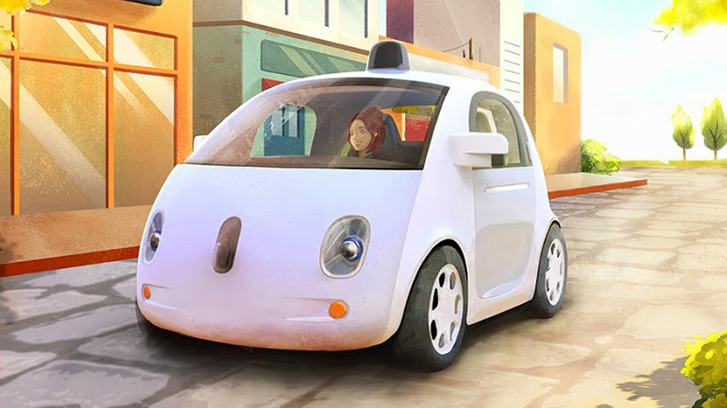
Future Plans
Notes:
-Google will probably license its technology to an automaker
-The cars will probably start off confined to limited areas for ride-sharing communities
-Google’s self-driving car system could be commercially available as soon as 2017

Slide 17
Any Questions?
http://content.usatoday.com/communities/driveon/post/2012/06/google-discloses-costs-of-its-driverless-car-tests/1#.VHOlT4vF-Ao
http://online.wsj.com/articles/SB10001424127887323864604579067100731362272
http://www.nhtsa.gov/About+NHTSA/Press+Releases/U.S.+Department+of+Transportation+Releases+Policy+on+Automated+Vehicle+Development
http://www.technologyreview.com/news/530276/hidden-obstacles-for-googles-self-driving-cars/
http://www.forbes.com/sites/jimgorzelany/2013/09/23/most-consumers-say-theyll-snub-self-driving-cars-survey-says/
http://www.mercurynews.com/business/ci_26924786/googles-self-driving-cars-learning-deal-bizarre-is
http://spectrum.ieee.org/cars-that-think/transportation/self-driving/google-works-with-nasa-to-test-cars-without-backup-drivers
http://www.wired.com/2012/04/google-autonomous-lexus-rx450h/
https://www.youtube.com/channel/UCCLyNDhxwpqNe3UeEmGHl8g
https://greybmusings.wordpress.com/2014/06/14/google-driverless-car-the-obstacle-detection-unit/

